Slide 1
Introductory Workshop in Bioinformatics – Part 4
WPM18: Protein Misfolding and Aggregation in Neurodegenerative Diseases
Dr. Jenny Russ
5.9.2022

Slide 2
How do we analyze data?

Slide 3
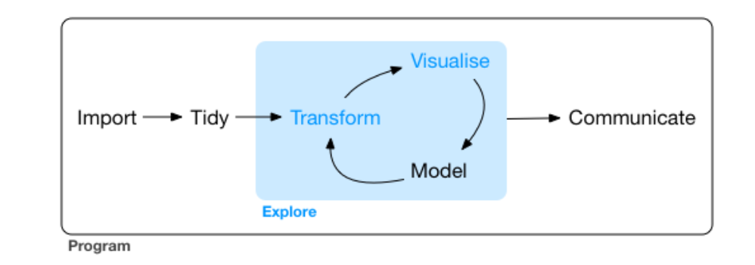
Data Analysis Workflow
https://r4ds.had.co.nz/explore-intro.html

Slide 4

https://www.tidyverse.org/images/hex-tidyverse.png

Slide 5
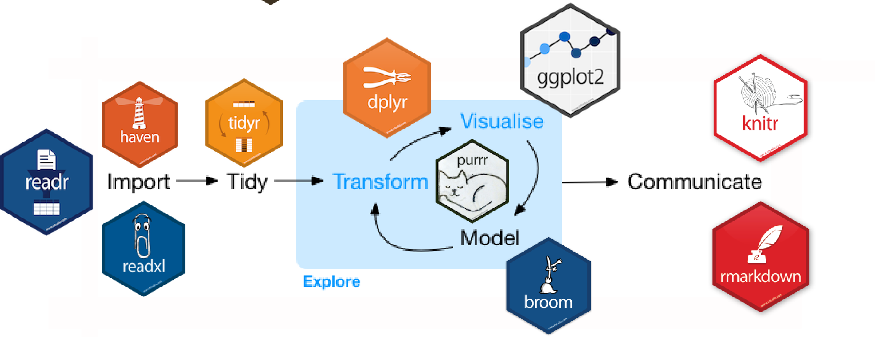
The Tidyverse
https://beanumber.github.io/tidy-databases/tidy_databases_slides.html#section

Slide 6
Outline
Wrangling the titanic dataset
Hands-on activity with mtcars dataset
Plotting the titanic dataset with ggplot2
Hands-on activity with iris dataset
Incorporating statistics into graphs with ggpubr

Slide 7
Getting started with Tidyverse

Slide 8
The pipe operator
data %>% function(arguments)
data %>%
f1() %>%
f2() %>%
f3()
data_tidy <- data %>%
f1() %>%
f2() %>%
f3()
function(data, arguments)
f3(f2(f1(data)))
data1 <- f1(data)
data2 <- f2(data1)
data_tidy <- f3(data2)

Slide 9
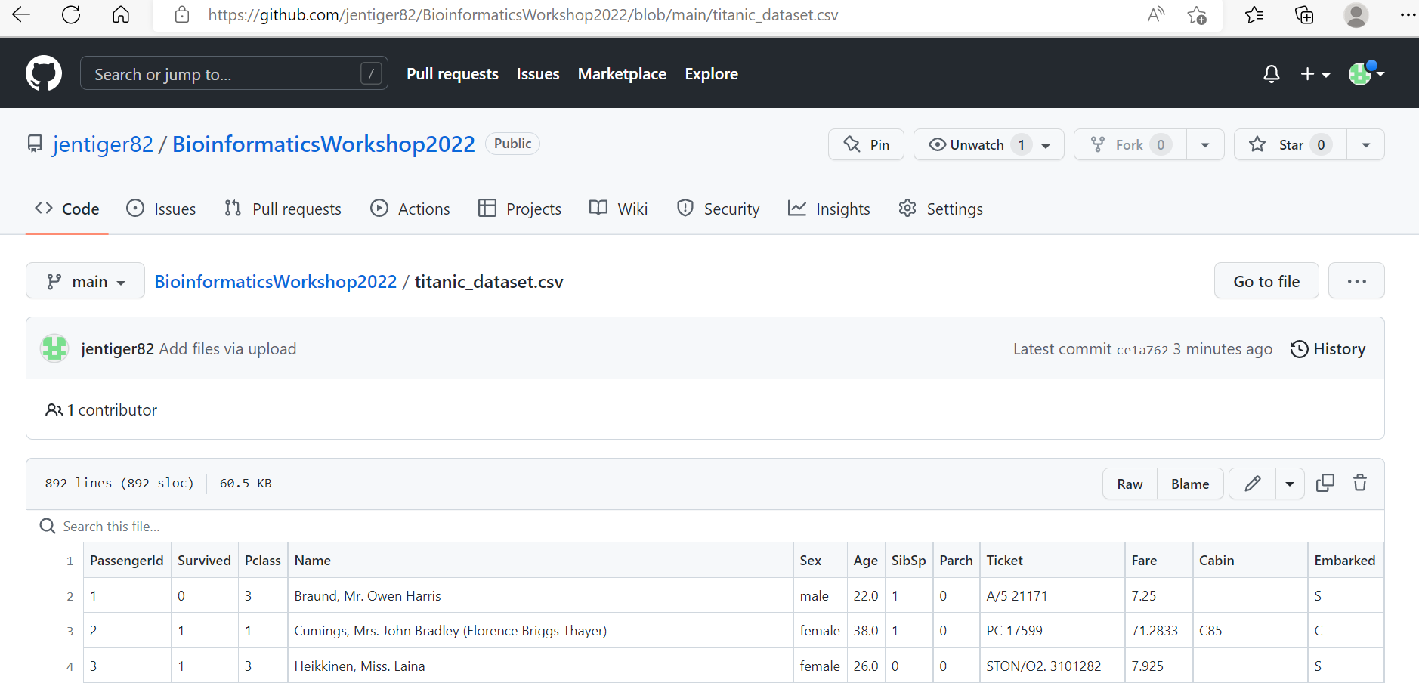

Slide 10
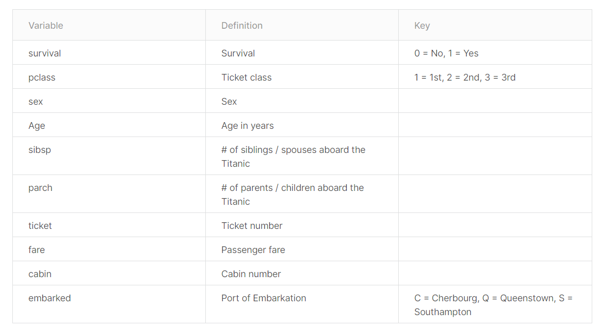

Slide 11
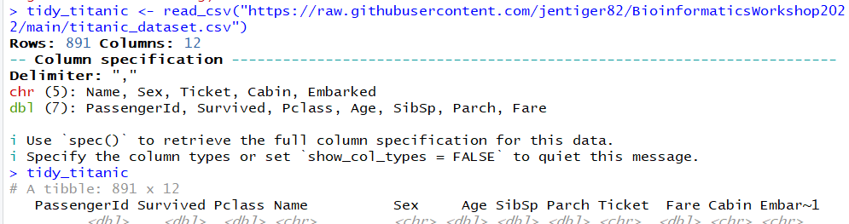
Getting the data (readr)

Slide 12
The filter verb
tidy_titanic %>% filter(Age > 12)

Slide 13
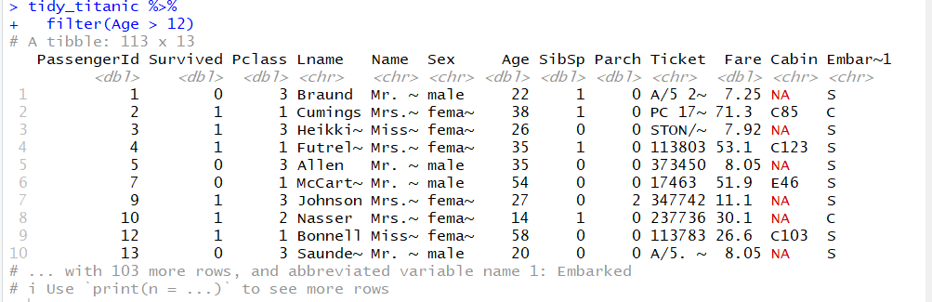
The filter verb

Slide 14
The select verb
tidy_titanic %>% filter(Age > 12) %>% select(Survived, Sex)

Slide 15
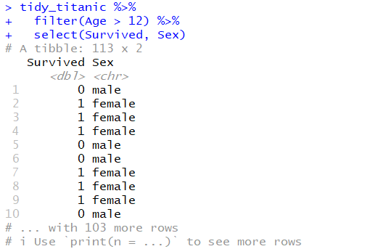
The select verb

Slide 16
The group_by verb
tidy_titanic %>% filter(Age > 12) %>% select(Survived, Sex) %>% group_by(Sex, Survived)

Slide 17
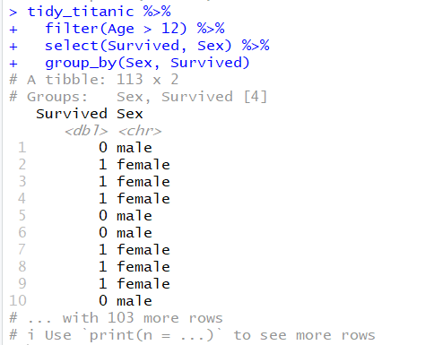
The group_by verb

Slide 18
The summarise verb
tidy_titanic %>% filter(Age > 12) %>% select(Survived, Sex) %>% group_by(Sex, Survived) %>% summarise(num_sex_survive = n())

Slide 19
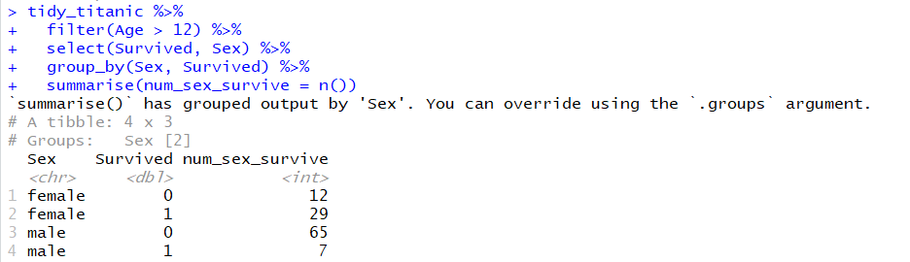
The summarise verb
Percent values?

Slide 20
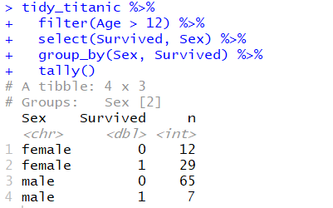
Alternative to summarize() is tally()

Slide 21
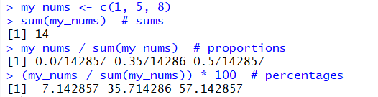
How do we calculate the percentage?
By using the function sum()

Slide 22
The mutate verb
tidy_titanic %>% filter(Age > 12) %>% select(Survived, Sex) %>% group_by(Sex, Survived) %>% summarise(num_sex_survive = n()) %>% mutate(pct_sex_survive = num_sex_survive/sum(num_sex_survive) * 100)

Slide 23
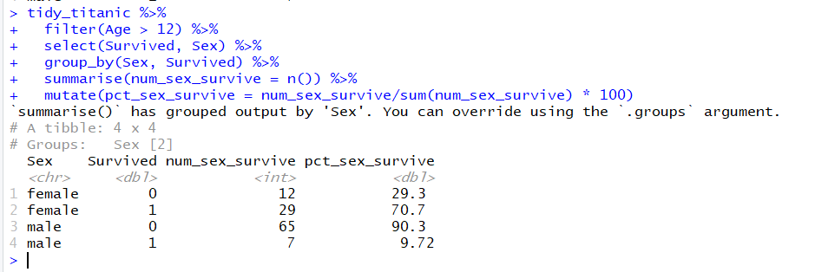
The mutate verb

Slide 24
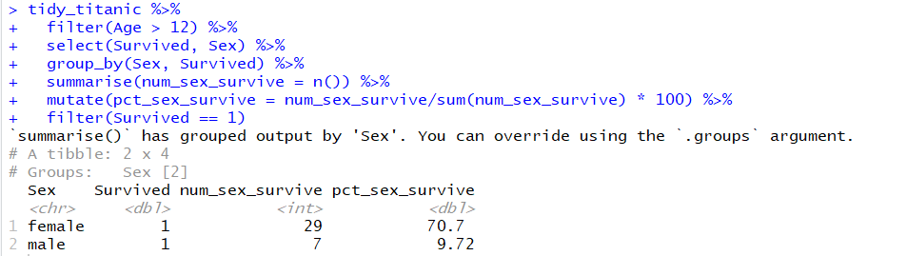
Keep only those surviving

Slide 25
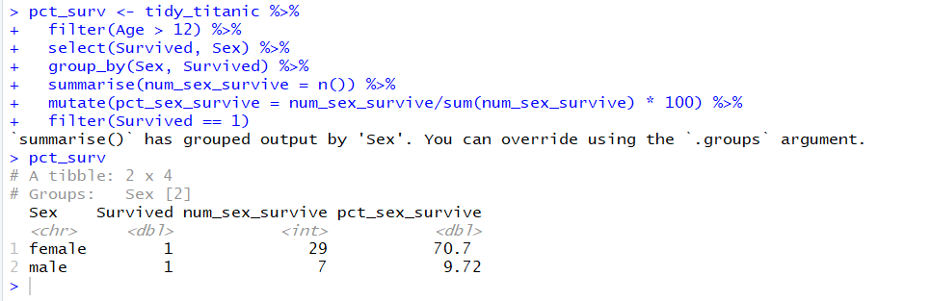
Save in variable

Slide 26
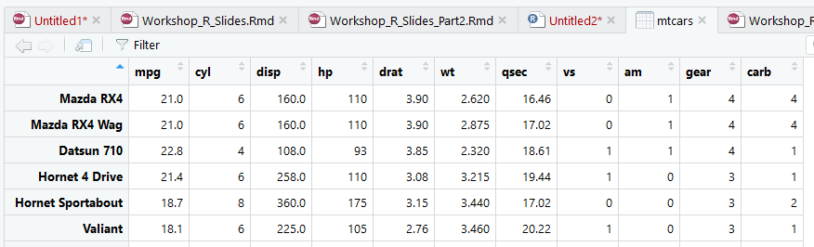
Hands on exercise 1 - mtcars
View(mtcars) # opens the dataset in an additional window in RStudio

Slide 27
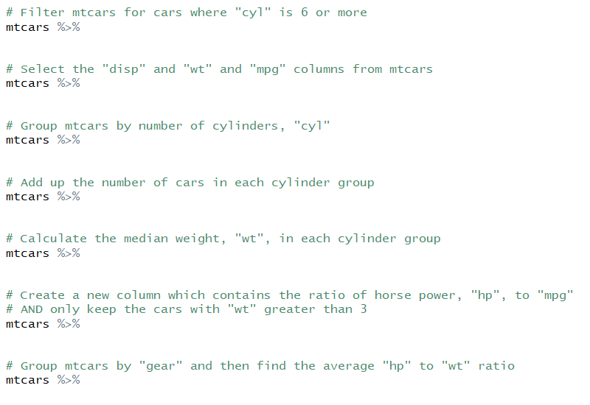
Hands on exercise 1 - mtcars

Slide 28
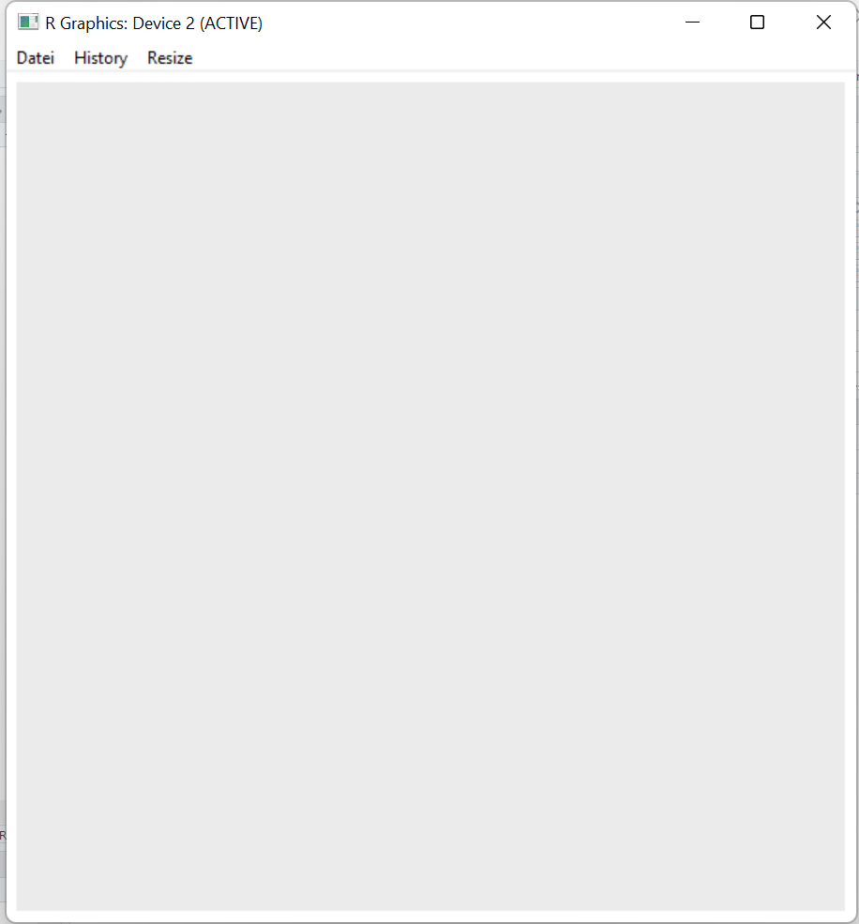
Setting the data layer
ggplot(data = pct_surv)

Slide 29
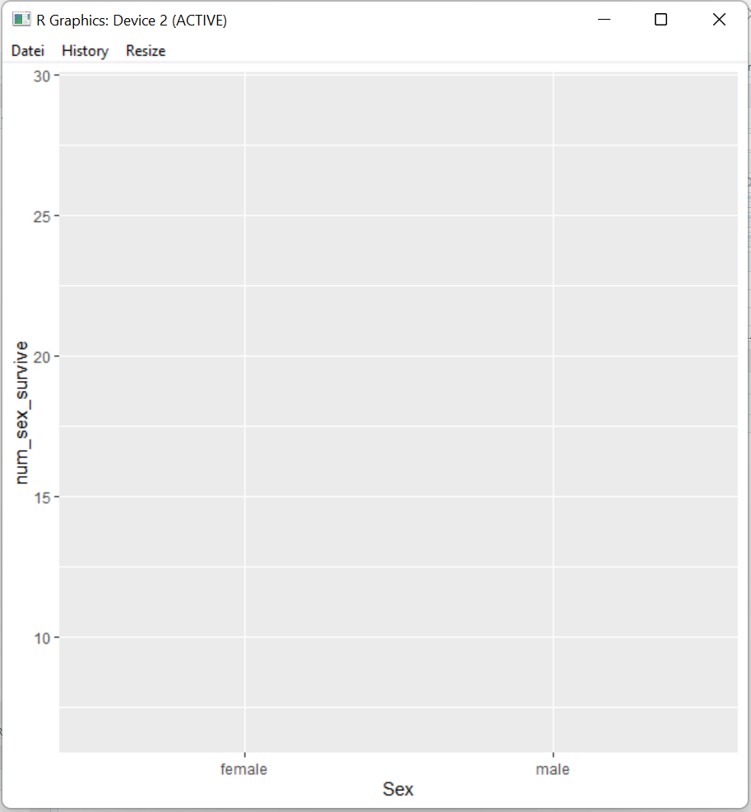
Setting the aesthetic layer
ggplot(data = pct_surv, mapping = aes(x = Sex, y = num_sex_survive))

Slide 30
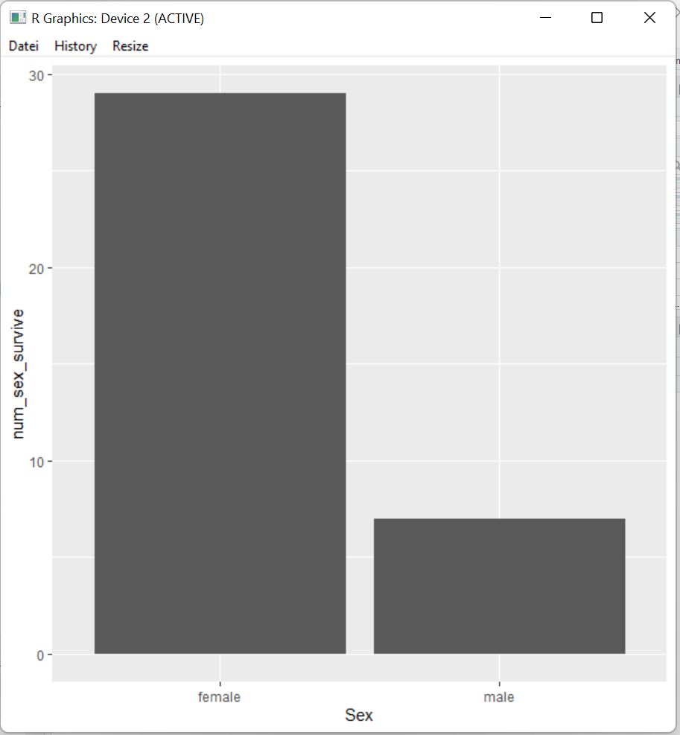
Setting the geometry layer
ggplot(data = pct_surv, mapping = aes(x = Sex, y = num_sex_survive)) + geom_bar(stat = "identity")

Slide 31
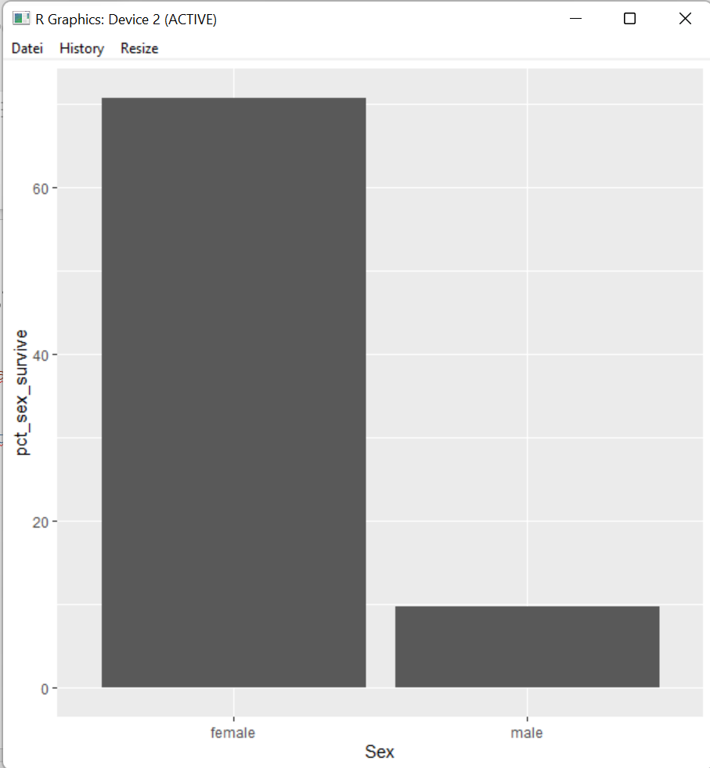
Switching the aesthetics with aes()
ggplot(data = pct_surv, mapping = aes(x = Sex, y = num_sex_survive)) + geom_bar(stat = "identity")

Slide 32

Theme: Changing the y-axis label
ggplot(data = pct_surv, mapping = aes(x = Sex, y = pct_sex_survive)) + geom_bar(stat = "identity") + ylab("Percentage Surviving")

Slide 33
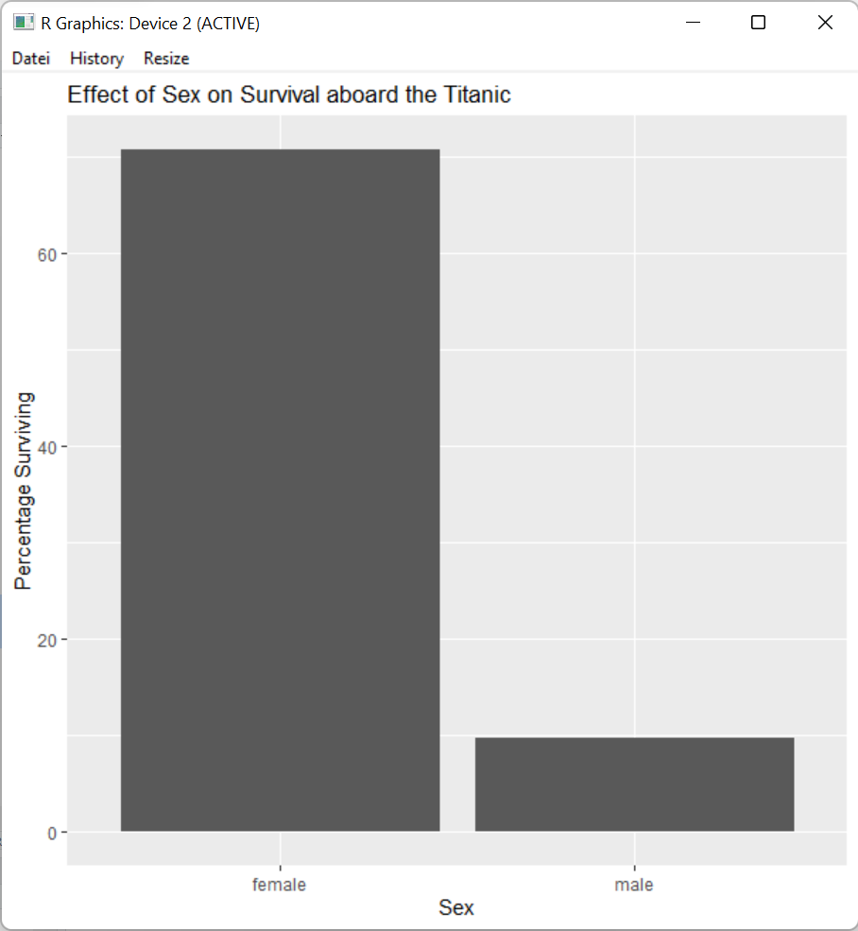
Theme: Adding a title
ggplot(data = pct_surv, mapping = aes(x = Sex, y = pct_sex_survive)) + geom_bar(stat = "identity") + ylab("Percentage Surviving") + labs(title = "Effect of Sex on Survival aboard the Titanic")

Slide 34
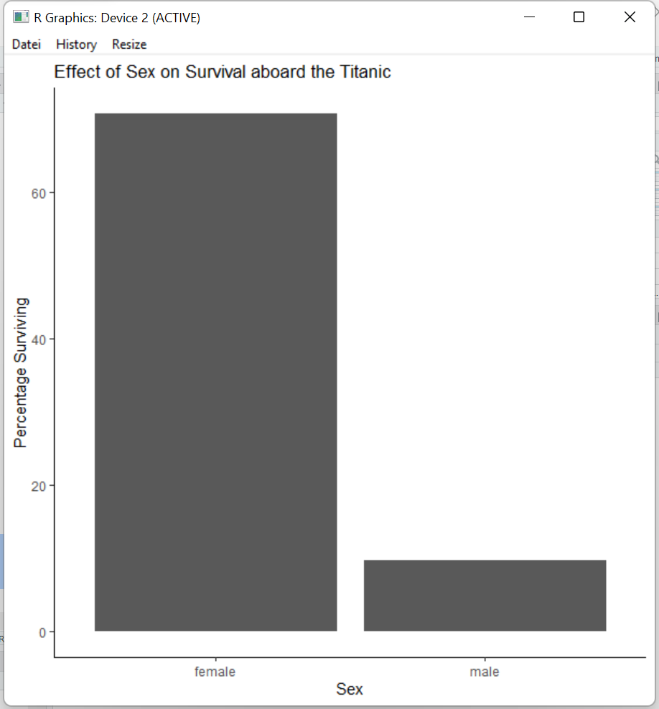
Theme: changing the overall style
ggplot(data = pct_surv, mapping = aes(x = Sex, y = pct_sex_survive)) + geom_bar(stat = "identity") + ylab("Percentage Surviving") + labs(title = "Effect of Sex on Survival aboard the Titanic") + theme_classic()

Slide 35
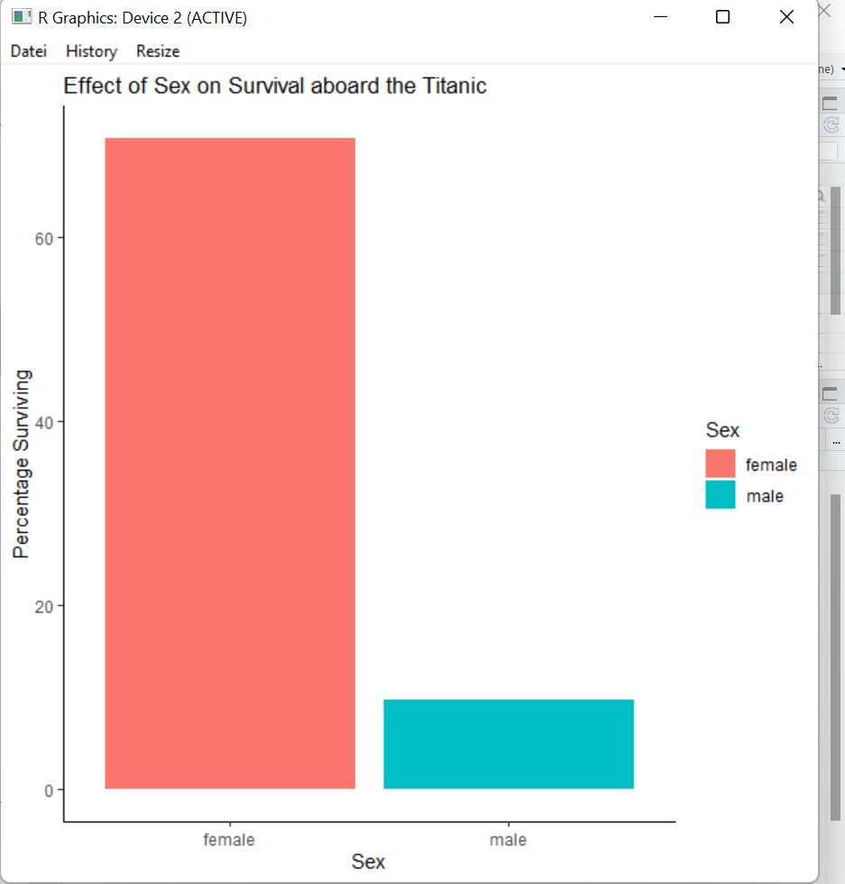
Adding a fill aesthetic
ggplot(data = pct_surv, mapping = aes(x = Sex, y = pct_sex_survive, fill = Sex)) + geom_bar(stat = "identity") + ylab("Percentage Surviving") + labs(title = "Effect of Sex on Survival aboard the Titanic") + theme_classic()

Slide 36
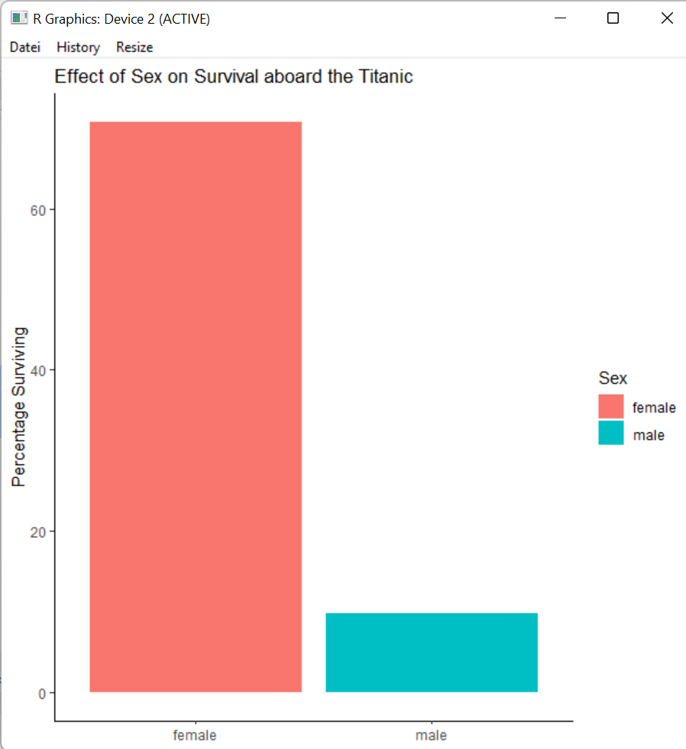
Theme: Remove the x-axis label
ggplot(data = pct_surv, mapping = aes(x = Sex, y = pct_sex_survive, fill = Sex)) + geom_bar(stat = "identity") + ylab("Percentage Surviving") + labs(title = "Effect of Sex on Survival aboard the Titanic") + theme_classic() + xlab(NULL)

Slide 37
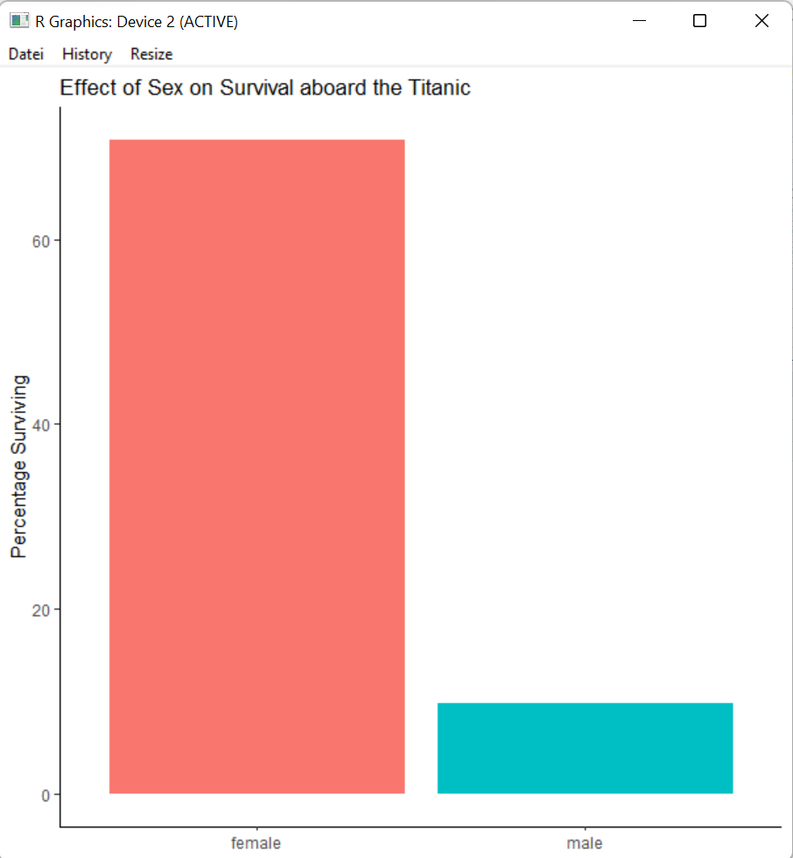
Theme: removing a legend
ggplot(data = pct_surv, mapping = aes(x = Sex, y = pct_sex_survive, fill = Sex)) + geom_bar(stat = "identity") + ylab("Percentage Surviving") + labs(title = "Effect of Sex on Survival aboard the Titanic") + theme_classic() + xlab(NULL) + theme(legend.position = "none")

Slide 38
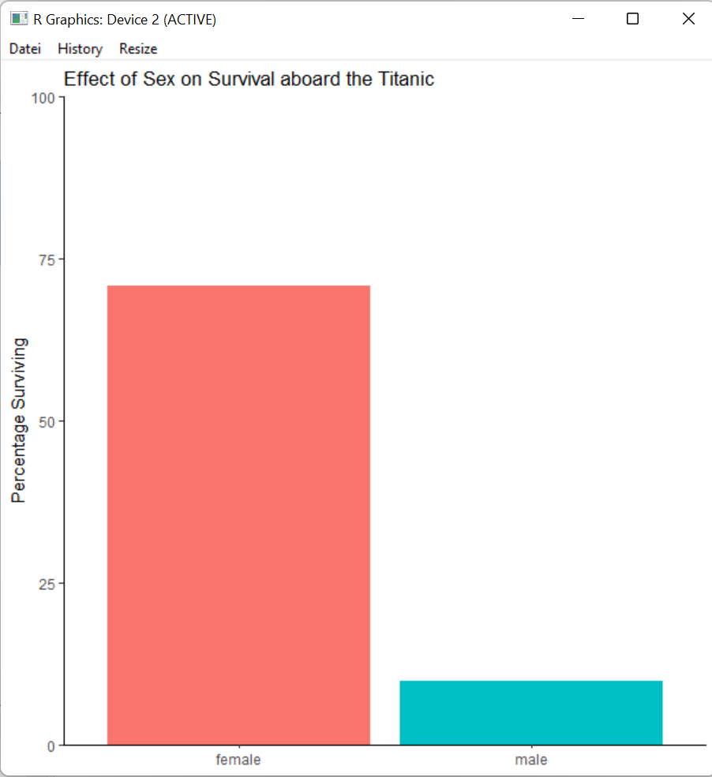
Coordinates: adjusting the y-axis scale
ggplot(data = pct_surv, mapping = aes(x = Sex, y = pct_sex_survive, fill = Sex)) + geom_bar(stat = "identity") + ylab("Percentage Surviving") + labs(title = "Effect of Sex on Survival aboard the Titanic") + theme_classic() + xlab(NULL) + theme(legend.position = "none") + scale_y_continuous(limits = c(0, 100), expand = c(0, 0))

Slide 39
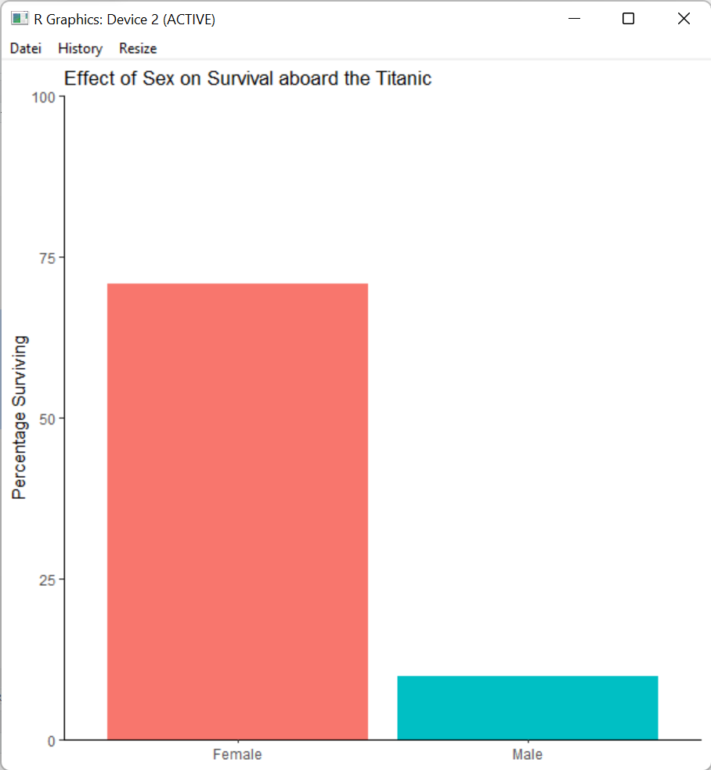
Coordinates: adjust the x-axis text labels
ggplot(data = pct_surv, mapping = aes(x = Sex, y = pct_sex_survive, fill = Sex)) + geom_bar(stat = "identity") + ylab("Percentage Surviving") + labs(title = "Effect of Sex on Survival aboard the Titanic") + theme_classic() + xlab(NULL) + theme(legend.position = "none") + scale_y_continuous(limits = c(0, 100), expand = c(0, 0)) + scale_x_discrete(labels = c("Female", "Male"))

Slide 40
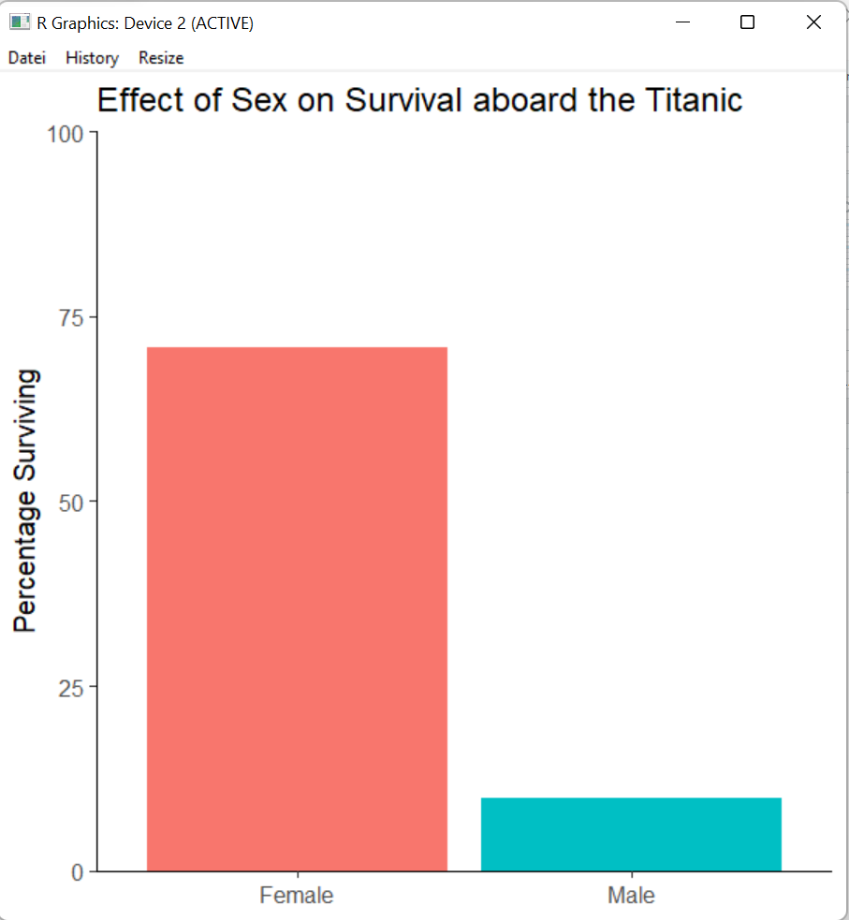
Theme: Setting the font size
ggplot(data = pct_surv, mapping = aes(x = Sex, y = pct_sex_survive, fill = Sex)) + geom_bar(stat = "identity") + ylab("Percentage Surviving") + labs(title = "Effect of Sex on Survival aboard the Titanic") + theme_classic(base_size = 17) + xlab(NULL) + theme(legend.position = "none") + scale_y_continuous(limits = c(0, 100), expand = c(0, 0)) + scale_x_discrete(labels = c("Female", "Male"))

Slide 41
Assigning ggplots to a variable
my_figure <- ggplot(data = pct_surv, mapping = aes(x = Sex, y = pct_sex_survive, fill = Sex)) + geom_bar(stat = "identity") + ylab("Percentage Surviving") + labs(title = "Effect of Sex on Survival aboard the Titanic") + theme_classic(base_size = 17) + xlab(NULL) + theme(legend.position = "none") + scale_y_continuous(limits = c(0, 100), expand = c(0, 0)) + scale_x_discrete(labels = c("Female", "Male")) my_figure

Slide 42
Saving a plot with ggsave()
ggsave(plot = my_figure, filename = "my_fig.png", width = 7, height = 4.5)

Slide 43
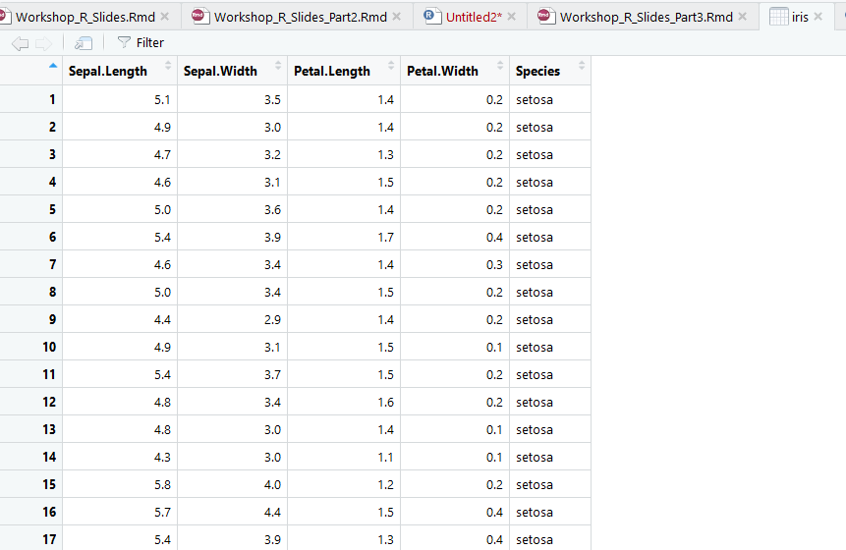
Hands on exercise 2 - Iris
View(iris) # opens the dataset in an additional window in RStudio

Slide 44
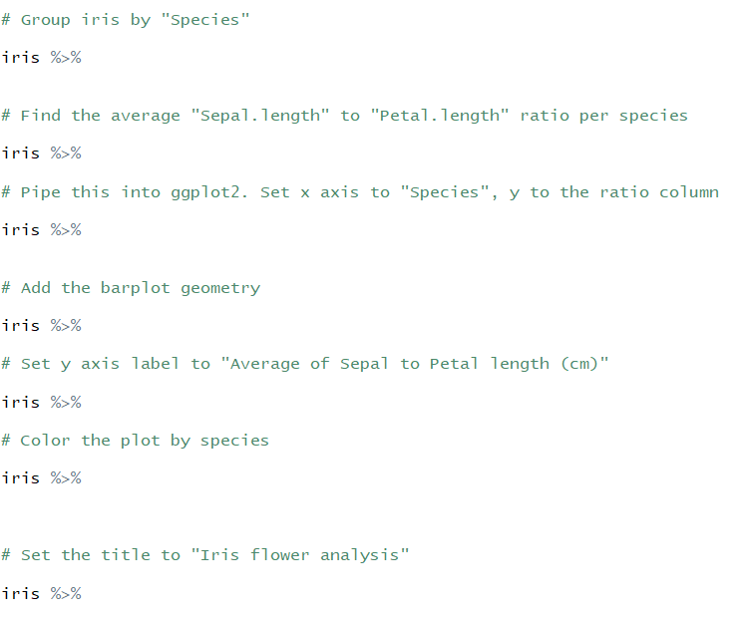
Hands on exercise 2 - Iris

Slide 45
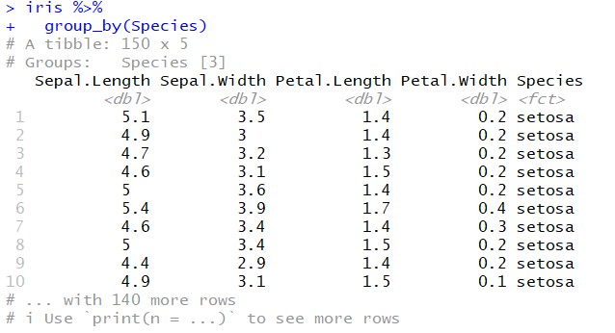
Group iris by „species“

Slide 46
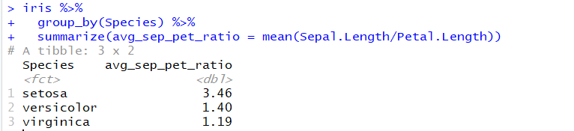
Average “sepal.length” to “petal.length” ratio per species

Slide 47

Pipe to ggplot2

Slide 48
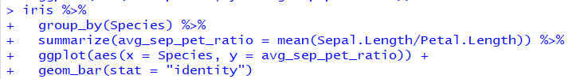
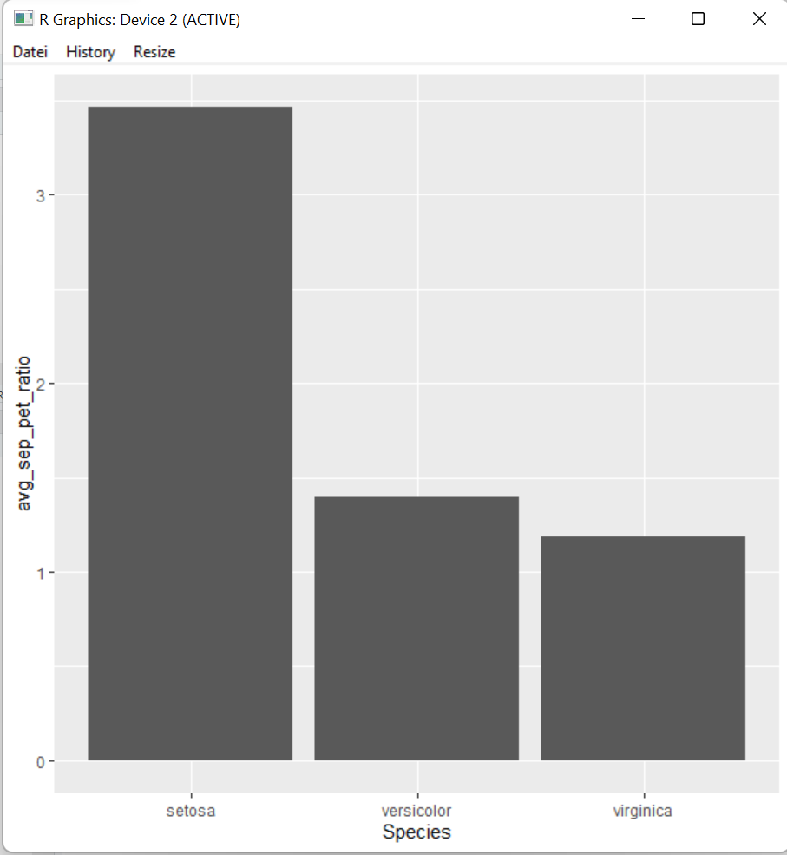
Add barplots

Slide 49
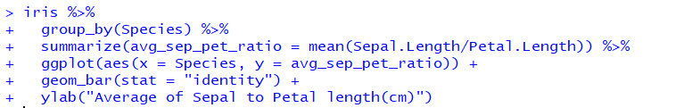
Change y-axis title

Slide 50
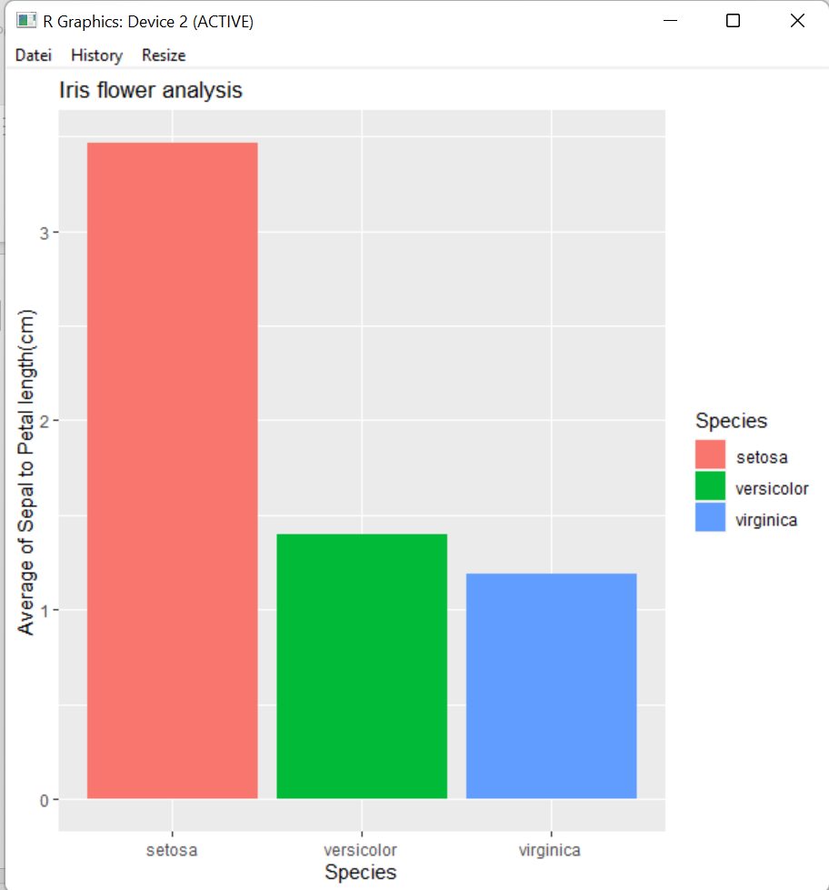
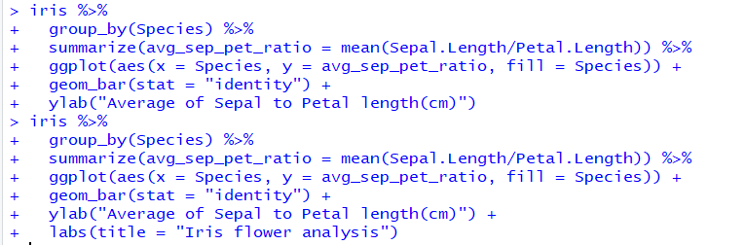
Color plot by “species” and add figure title

Slide 51
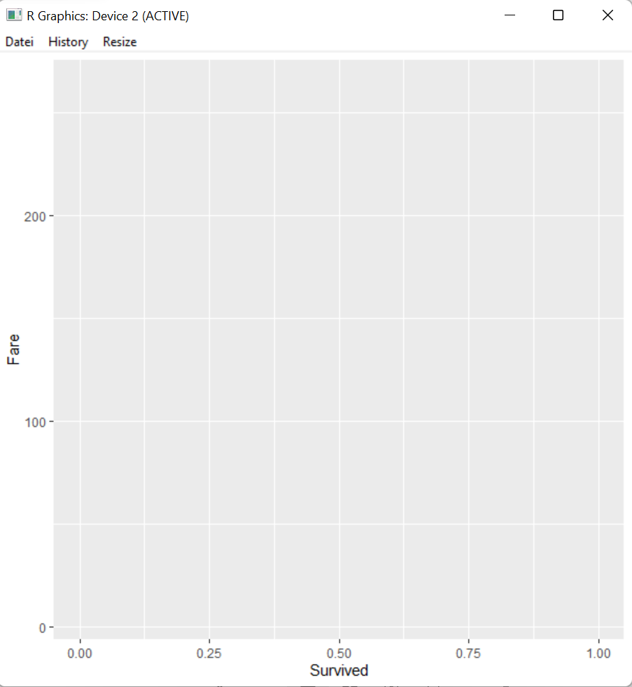
Does Fare predict Survival?
Variable “Survived” is being treated as a continuous variable

Slide 52
Change it to a discrete variable with factor()

Slide 53
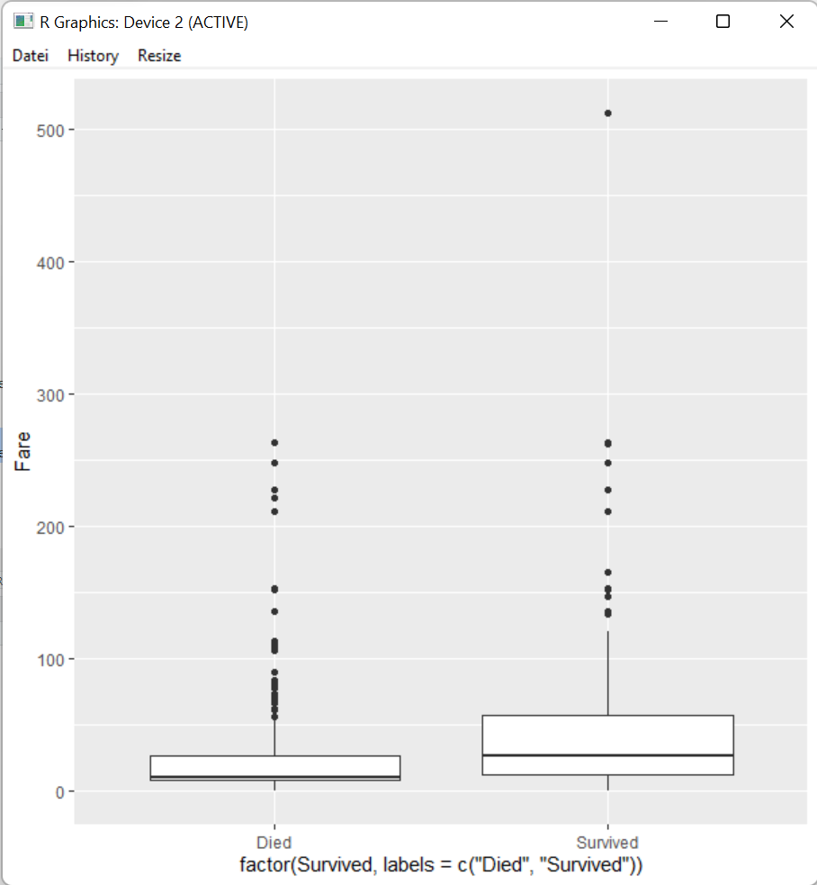
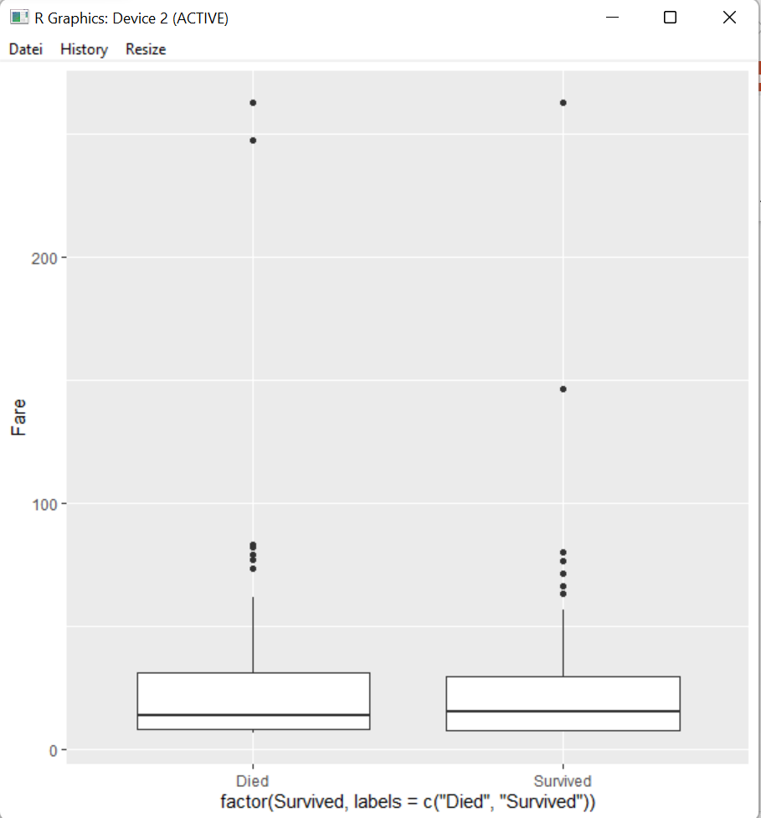
Show distribution of values as boxplot

Slide 54

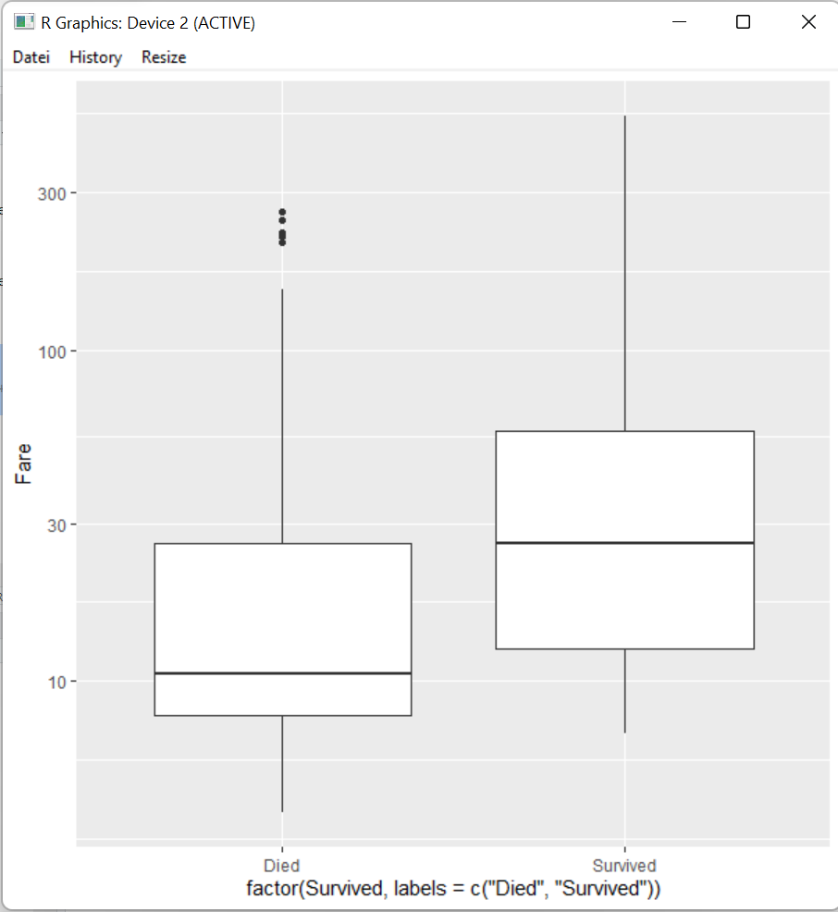
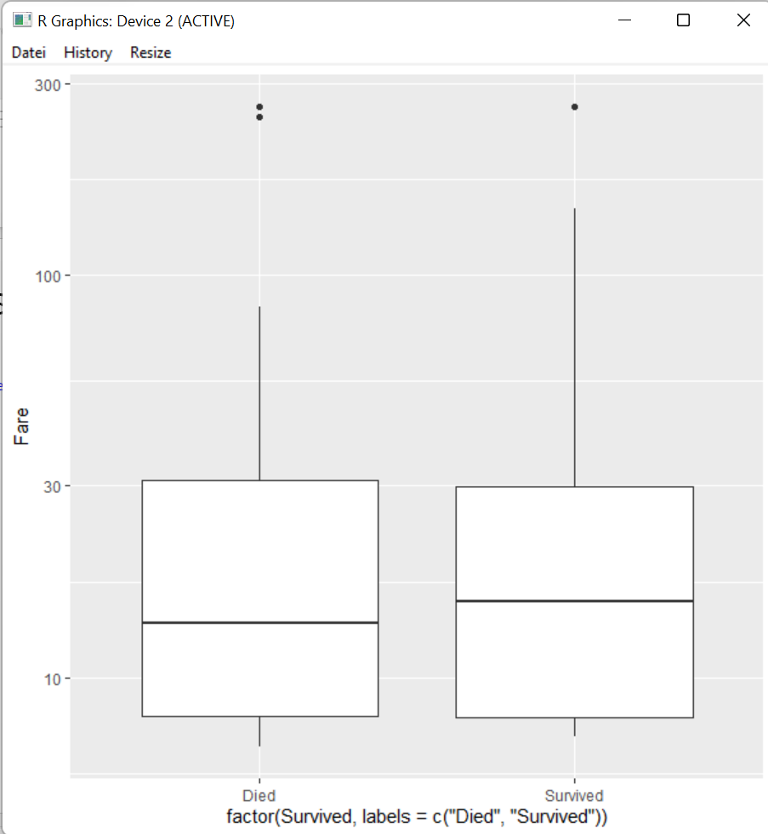
Log scale of y-axis

Slide 55
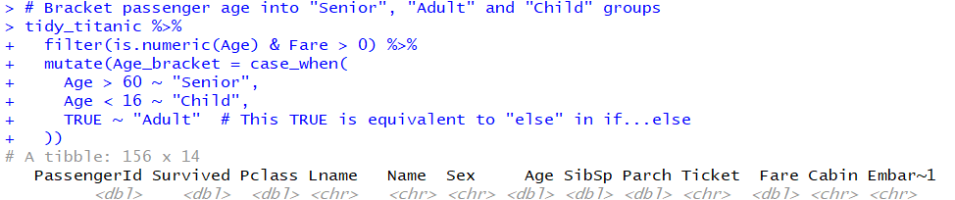

Slide 56
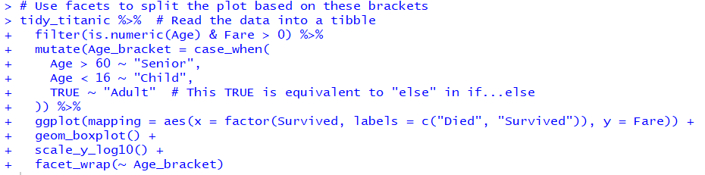
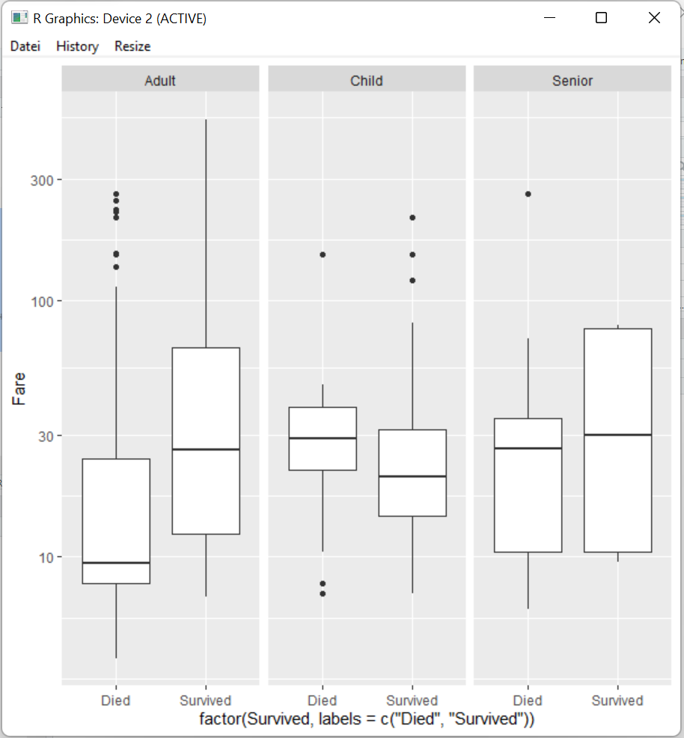
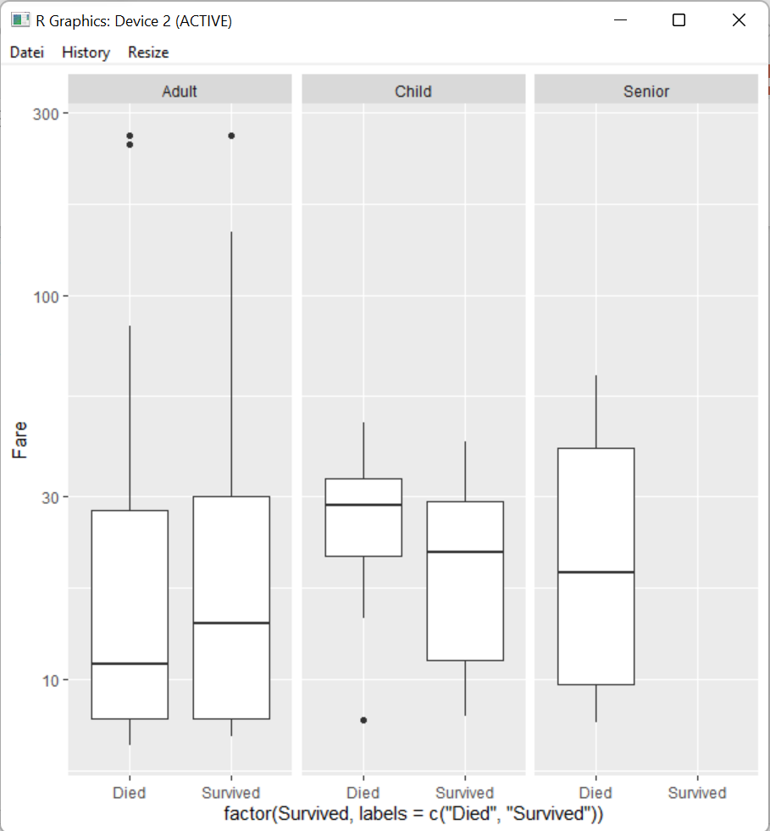

Slide 57
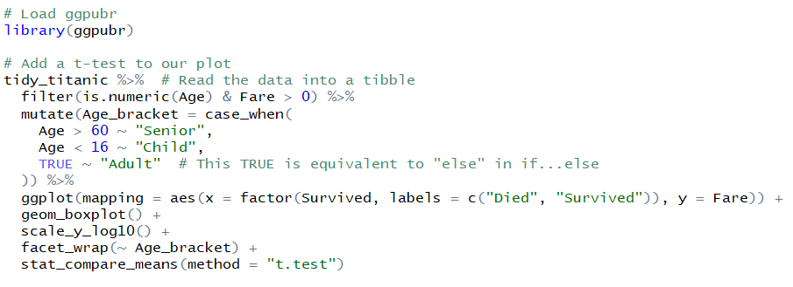
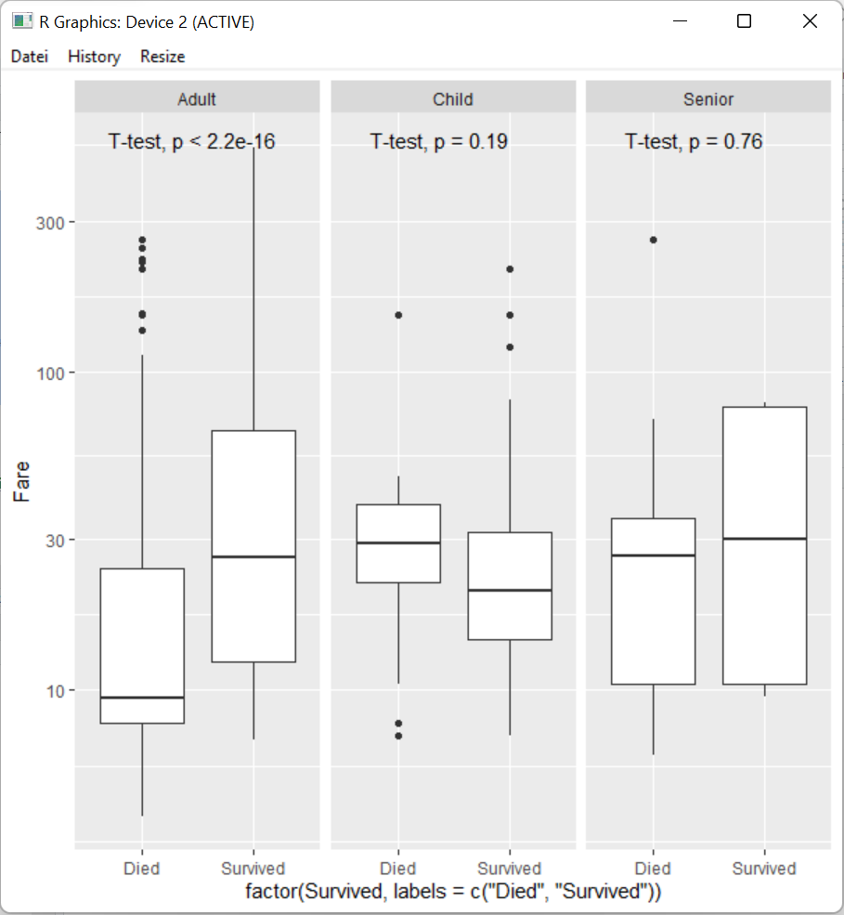

Slide 58
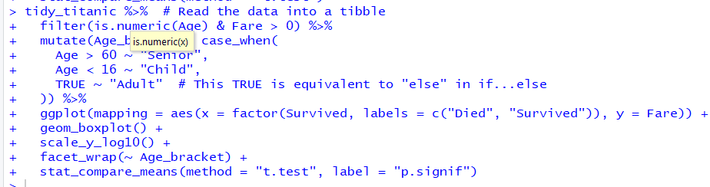
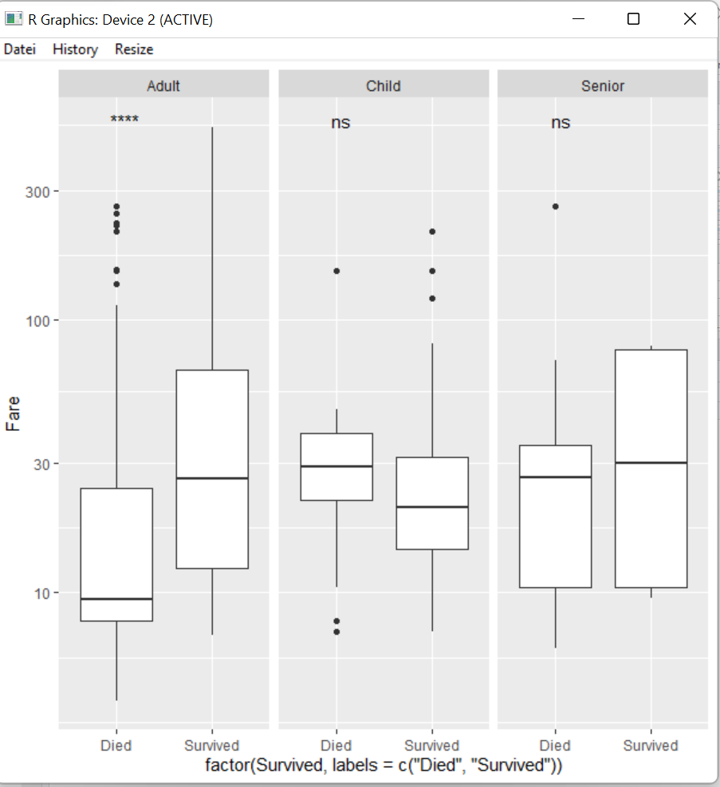

Slide 59



Slide 60


Slide 61


Slide 62
Analyzing biomedical data with tidyverse and ggpubr
Using luminescence data from a plate reader

Slide 63

Measuring tau aggregation via luminescence
Tau is fused to luciferase fragments
Aggregating tau reconstitutes luciferase activity
Feeding flies substrate produces light detected by plate reader
EGFP should not aggregate ➔ Control

Slide 64


Slide 65
Specify the plate layout
plate_layout <- data.frame(Row = c("A", "B", "C"), Genotpye = c("tau_AGG", "EGPF_AGG_1", "EGFP_AGG_2")
Row Genotype
1 A tau_AGG
2 B EGFP_AGG_1
3 C EGFP_AGG_2

Slide 66

Parse well position into row and column
luminescence %>%
mutate(Row = substr(WellPosition, 1, 1)) %>%
mutate(Column = substr(WellPosition, 3, 3))

Slide 67

Select relevant data
luminescence %>%
mutate(Row = substr(WellPosition, 1, 1)) %>%
mutate(Column = substr(WellPosition, 3, 3)) %>%
select(Luminescence = "RLU", Row, Column)

Slide 68

Merge plate layout
luminescence %>%
mutate(Row = substr(WellPosition, 1, 1)) %>%
mutate(Column = substr(WellPosition, 3, 3)) %>%
select(Luminescence = "RLU", Row, Column) %>%
left_join(plate_layout, by = "Row")

Slide 69
Group by genotype
luminescence %>%
mutate(Row = substr(WellPosition, 1, 1)) %>%
mutate(Column = substr(WellPosition, 3, 3)) %>%
select(Luminescence = "RLU", Row, Column) %>%
left_join(plate_layout, by = "Row") %>%
group_by(Genotype)

Slide 70
Calculate mean within groups
luminescence %>%
mutate(Row = substr(WellPosition, 1, 1)) %>%
mutate(Column = substr(WellPosition, 3, 3)) %>%
select(Luminescence = "RLU", Row, Column) %>%
left_join(plate_layout, by = "Row") %>%
group_by(Genotype) %>%
mutate(Luminescence_Mean = mean(Luminescence))
# A tibble: 18 x 5
# Groups: Genotype [3]
Luminescence Row Column Genotype Luminescence_Mean
<dbl> <chr> <chr> <chr> <dbl>
1 1795 A 1 tau_AGG 2000.
2 1564 A 2 tau_AGG 2000.
3 2984 A 3 tau_AGG 2000.
4 2330 A 4 tau_AGG 2000.
5 1819 A 5 tau_AGG 2000.
6 1509 A 6 tau_AGG 2000.
7 1515 B 1 EGFP_AGG_1 1386.
8 1024 B 2 EGFP_AGG_1 1386.
9 1580 B 3 EGFP_AGG_1 1386.
10 1453 B 4 EGFP_AGG_1 1386.
11 1628 B 5 EGFP_AGG_1 1386.
12 1115 B 6 EGFP_AGG_1 1386.
13 796 C 1 EGFP_AGG_2 801
14 818 C 2 EGFP_AGG_2 801
15 375 C 3 EGFP_AGG_2 801
16 765 C 4 EGFP_AGG_2 801
17 858 C 5 EGFP_AGG_2 801
18 1194 C 6 EGFP_AGG_2 801

Slide 71

Calculate SD within groups
luminescence %>%
mutate(Row = substr(WellPosition, 1, 1)) %>%
mutate(Column = substr(WellPosition, 3, 3)) %>%
select(Luminescence = "RLU", Row, Column) %>%
left_join(plate_layout, by = "Row") %>%
group_by(Genotype) %>%
mutate(Luminescence_Mean = mean(Luminescence)) %>%
mutate(Luminescence_Stdev = sd(Luminescence))

Slide 72
Calculate SEM within groups
luminescence %>%
mutate(Row = substr(WellPosition, 1, 1)) %>%
mutate(Column = substr(WellPosition, 3, 3)) %>%
select(Luminescence = "RLU", Row, Column) %>%
left_join(plate_layout, by = "Row") %>%
group_by(Genotype) %>%
mutate(Luminescence_Mean = mean(Luminescence)) %>%
mutate(Luminescence_Stdev = sd(Luminescence)) %>%
mutate(Luminescence_SEM = Luminescence_Stdev/sqrt(n()))
# A tibble: 18 x 7
# Groups: Genotype [3]
Luminescence Row Column Genotype Luminescence_Mean Luminescence_Stdev Luminescence_SEM
<dbl> <chr> <chr> <chr> <dbl> <dbl> <dbl>
1 1795 A 1 tau_AGG 2000. 563. 230.
2 1564 A 2 tau_AGG 2000. 563. 230.
3 2984 A 3 tau_AGG 2000. 563. 230.
4 2330 A 4 tau_AGG 2000. 563. 230.
5 1819 A 5 tau_AGG 2000. 563. 230.
6 1509 A 6 tau_AGG 2000. 563. 230.
7 1515 B 1 EGFP_AGG_1 1386. 254. 104.
8 1024 B 2 EGFP_AGG_1 1386. 254. 104.
9 1580 B 3 EGFP_AGG_1 1386. 254. 104.
10 1453 B 4 EGFP_AGG_1 1386. 254. 104.
11 1628 B 5 EGFP_AGG_1 1386. 254. 104.
12 1115 B 6 EGFP_AGG_1 1386. 254. 104.
13 796 C 1 EGFP_AGG_2 801 261. 107.
14 818 C 2 EGFP_AGG_2 801 261. 107.
15 375 C 3 EGFP_AGG_2 801 261. 107.
16 765 C 4 EGFP_AGG_2 801 261. 107.
17 858 C 5 EGFP_AGG_2 801 261. 107.
18 1194 C 6 EGFP_AGG_2 801 261. 107.

Slide 73
Pipe tidy data to ggplot
luminescence %>%
mutate(Row = substr(WellPosition, 1, 1)) %>%
mutate(Column = substr(WellPosition, 3, 3)) %>%
select(Luminescence = "RLU", Row, Column) %>%
left_join(plate_layout, by = "Row") %>%
group_by(Genotype) %>%
mutate(Luminescence_Mean = mean(Luminescence)) %>%
mutate(Luminescence_Stdev = sd(Luminescence)) %>%
mutate(Luminescence_SEM = Luminescence_Stdev/sqrt(n())) %>%
ggplot(mapping = aes(x = factor(Genotype, levels = c("tau_AGG", "EGFP_AGG_1", "EGFP_AGG_2")), y = Luminescence))

Slide 74


Slide 75
Add geometry
luminescence %>%
mutate(Row = substr(WellPosition, 1, 1)) %>%
mutate(Column = substr(WellPosition, 3, 3)) %>%
select(Luminescence = "RLU", Row, Column) %>%
left_join(plate_layout, by = "Row") %>%
group_by(Genotype) %>%
mutate(Luminescence_Mean = mean(Luminescence)) %>%
mutate(Luminescence_Stdev = sd(Luminescence)) %>%
mutate(Luminescence_SEM = Luminescence_Stdev/sqrt(n())) %>%
ggplot(mapping = aes(x = factor(Genotype, levels = c("tau_AGG", "EGFP_AGG_1", "EGFP_AGG_2")), y = Luminescence)) +
geom_bar(stat = "summary", fun = "mean")

Slide 76


Slide 77
Add errorbars
luminescence %>%
mutate(Row = substr(WellPosition, 1, 1)) %>%
mutate(Column = substr(WellPosition, 3, 3)) %>%
select(Luminescence = "RLU", Row, Column) %>%
left_join(plate_layout, by = "Row") %>%
group_by(Genotype) %>%
mutate(Luminescence_Mean = mean(Luminescence)) %>%
mutate(Luminescence_Stdev = sd(Luminescence)) %>%
mutate(Luminescence_SEM = Luminescence_Stdev/sqrt(n())) %>%
ggplot(mapping = aes(x = factor(Genotype, levels = c("tau_AGG", "EGFP_AGG_1", "EGFP_AGG_2")), y = Luminescence)) +
geom_bar(stat = "summary", fun = "mean") +
geom_errorbar(aes(ymin = Luminescence_Mean - Luminescence_SEM, ymax = Luminescence_Mean + Luminescence_SEM))

Slide 78


Slide 79
Improve appearance
luminescence %>%
mutate(Row = substr(WellPosition, 1, 1)) %>%
mutate(Column = substr(WellPosition, 3, 3)) %>%
select(Luminescence = "RLU", Row, Column) %>%
left_join(plate_layout, by = "Row") %>%
group_by(Genotype) %>%
mutate(Luminescence_Mean = mean(Luminescence)) %>%
mutate(Luminescence_Stdev = sd(Luminescence)) %>%
mutate(Luminescence_SEM = Luminescence_Stdev/sqrt(n())) %>%
ggplot(mapping = aes(x = factor(Genotype, levels = c("tau_AGG", "EGFP_AGG_1", "EGFP_AGG_2")), y = Luminescence)) +
geom_bar(stat = "summary", fun = "mean") +
geom_errorbar(aes(ymin = Luminescence_Mean - Luminescence_SEM, ymax = Luminescence_Mean + Luminescence_SEM)) +
xlab("Genotype") +
ylab("Luminescence") +
labs(title = "Comparison of tau aggregation to EGFP controls") +
theme_classic()

Slide 80


Slide 81
Add ANOVA
luminescence %>%
mutate(Row = substr(WellPosition, 1, 1)) %>%
mutate(Column = substr(WellPosition, 3, 3)) %>%
select(Luminescence = "RLU", Row, Column) %>%
left_join(plate_layout, by = "Row") %>%
group_by(Genotype) %>%
mutate(Luminescence_Mean = mean(Luminescence)) %>%
mutate(Luminescence_Stdev = sd(Luminescence)) %>%
mutate(Luminescence_SEM = Luminescence_Stdev/sqrt(n())) %>%
ggplot(mapping = aes(x = factor(Genotype, levels = c("tau_AGG", "EGFP_AGG_1", "EGFP_AGG_2")), y = Luminescence)) +
geom_bar(stat = "summary", fun = "mean") +
geom_errorbar(aes(ymin = Luminescence_Mean - Luminescence_SEM, ymax = Luminescence_Mean + Luminescence_SEM)) +
xlab("Genotype") +
ylab("Luminescence") +
labs(title = "Comparison of tau aggregation to EGFP controls") +
theme_classic() +
stat_compare_means(method = "anova", label.y = 3700)

Slide 82


Slide 83
Add pairwise comparisons and save
luminescence %>%
mutate(Row = substr(WellPosition, 1, 1)) %>%
mutate(Column = substr(WellPosition, 3, 3)) %>%
select(Luminescence = "RLU", Row, Column) %>%
left_join(plate_layout, by = "Row") %>%
group_by(Genotype) %>%
mutate(Luminescence_Mean = mean(Luminescence)) %>%
mutate(Luminescence_Stdev = sd(Luminescence)) %>%
mutate(Luminescence_SEM = Luminescence_Stdev/sqrt(n())) %>%
ggplot(mapping = aes(x = factor(Genotype, levels = c("tau_AGG", "EGFP_AGG_1", "EGFP_AGG_2")), y = Luminescence)) +
geom_bar(stat = "summary", fun = "mean") +
geom_errorbar(aes(ymin = Luminescence_Mean - Luminescence_SEM, ymax = Luminescence_Mean + Luminescence_SEM)) +
xlab("Genotype") +
ylab("Luminescence") +
labs(title = "Comparison of tau aggregation to EGFP controls") +
theme_classic() +
stat_compare_means(method = "anova", label.y = 3700) +
stat_compare_means(method = "t.test", comparisons = list(c("tau_AGG", "EGFP_AGG_1"), c("tau_AGG", "EGFP_AGG_2")), label = "p.signif") +
ggsave("Raw_Luminescence.png")

Slide 84


Slide 85
Do the same thing, but normalize to tau_AGG
luminescence %>%
mutate(Row = substr(WellPosition, 1, 1)) %>%
mutate(Column = substr(WellPosition, 3, 3)) %>%
select(Luminescence = "RLU", Row, Column) %>%
left_join(plate_layout, by = "Row") %>%
mutate(Luminescence_Norm = Luminescence/mean(Luminescence[Genotype == "tau_AGG"])) %>%
group_by(Genotype) %>%
mutate(Luminescence_Norm_Mean = mean(Luminescence_Norm)) %>%
mutate(Luminescence_Norm_Stdev = sd(Luminescence_Norm)) %>%
mutate(Luminescence_Norm_SEM = Luminescence_Norm_Stdev/sqrt(n())) %>%
ggplot(mapping = aes(x = factor(Genotype, levels = c("tau_AGG", "EGFP_AGG_1", "EGFP_AGG_2")), y = Luminescence_Norm)) +
geom_bar(stat = "summary", fun = "mean") +
geom_errorbar(aes(ymin = Luminescence_Norm_Mean – Luminescence_Norm_SEM, ymax = Luminescence_Norm_Mean + Luminescence_Norm_SEM)) +
xlab("Genotype") +
ylab("Luminescence (normalized to tau_AGG") +
labs(title = "Comparison of tau aggregation to EGFP controls") +
theme_classic() +
stat_compare_means(method = "anova", label.y = 3700) +
stat_compare_means(method = "t.test", comparisons = list(c("tau_AGG", "EGFP_AGG_1"), c("tau_AGG", "EGFP_AGG_2")), label = "p.signif") +
ggsave("Normalized_Luminescence.png")

Slide 86


